Slide 1
Financial Analysis
Of
RAK Ceramics Ltd.
And
Shinepukur Ceramics Ltd.

Slide 2
Group 3 - Team Members
180041115, Md. Nakibul Ezaz
180041116, Nuzhat Nower
180041117, Faysal Mahmud
180041118, Sidratul Muntaha
180041119, Fariha Anjum
180041120, Farhan Ishmam
170041055, Md. Shohidul Islam

Slide 3
Table of
Contents
RAK Ceramics Ltd. (Horizontal and Vertical Analysis)
Shinepukur Ceramics Ltd. (Horizontal and Vertical Analysis)
InterCompany Analysis (Horizontal and Vertical Analysis)
Ratio Analysis

Slide 4

RAK Ceramics Ltd.

Slide 5
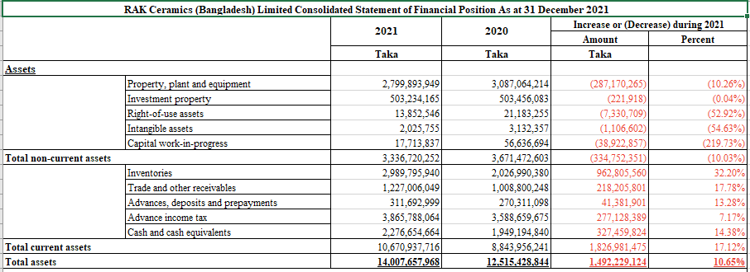
Horizontal Analysis

Slide 6
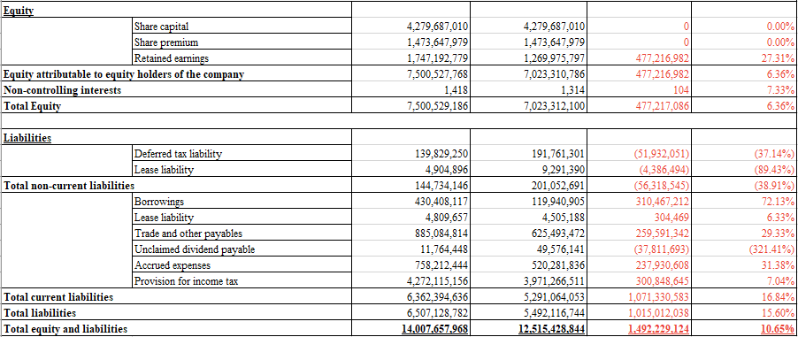
Horizontal Analysis

Slide 7
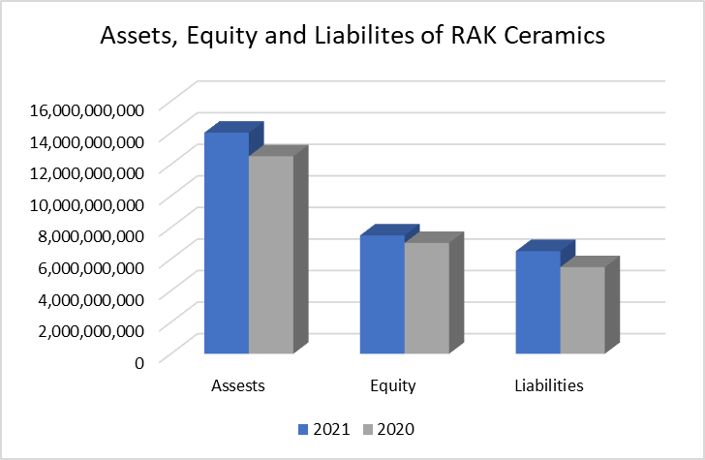

Slide 8
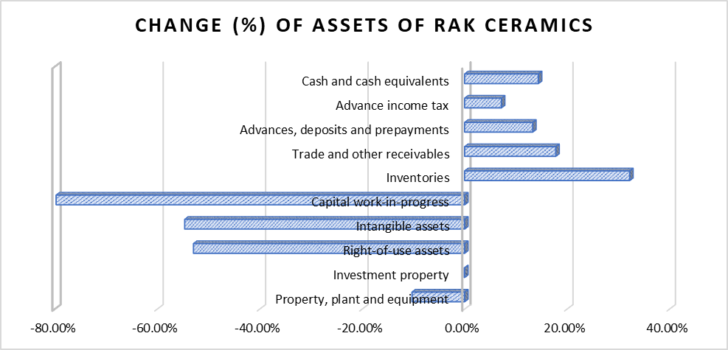
Increase in total Assets
10.65%
Major contribution
Trade and Other Receivables
Inventories

Slide 9
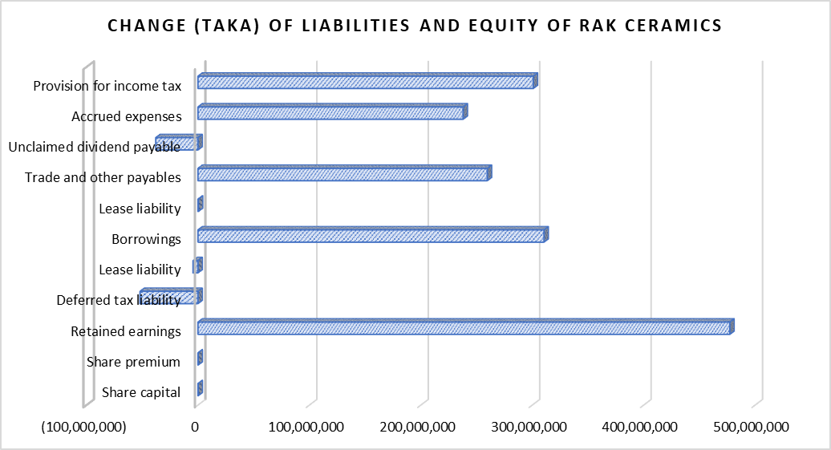
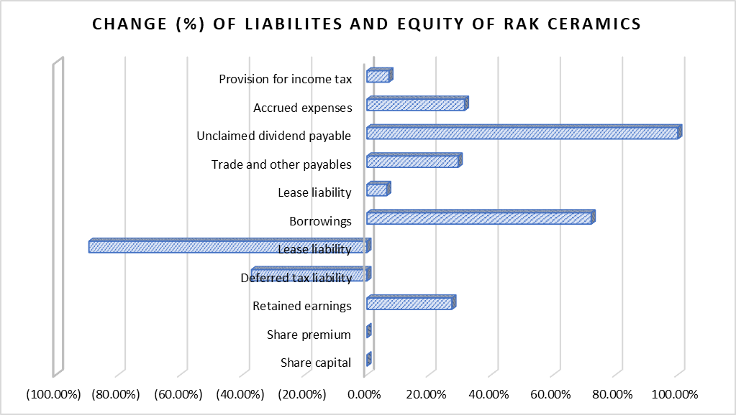

Slide 10
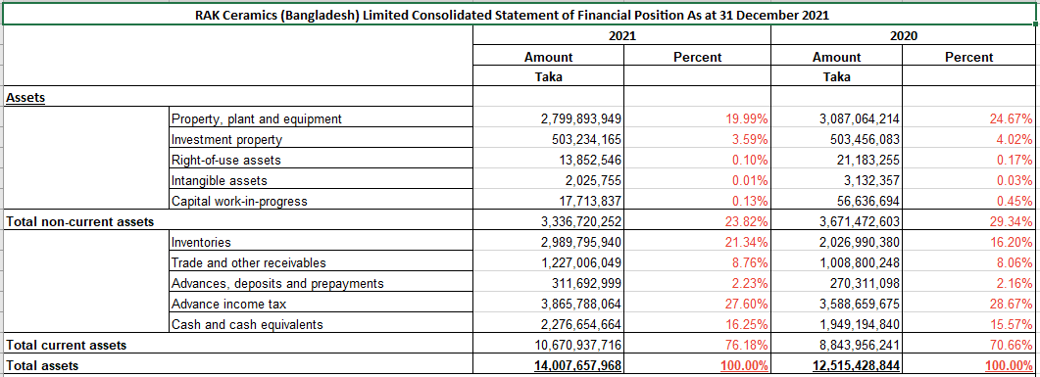
Vertical Analysis

Slide 11
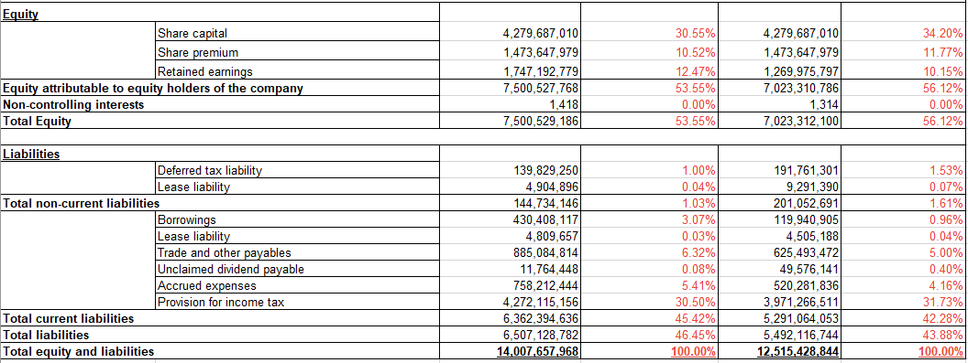
Vertical Analysis

Slide 12
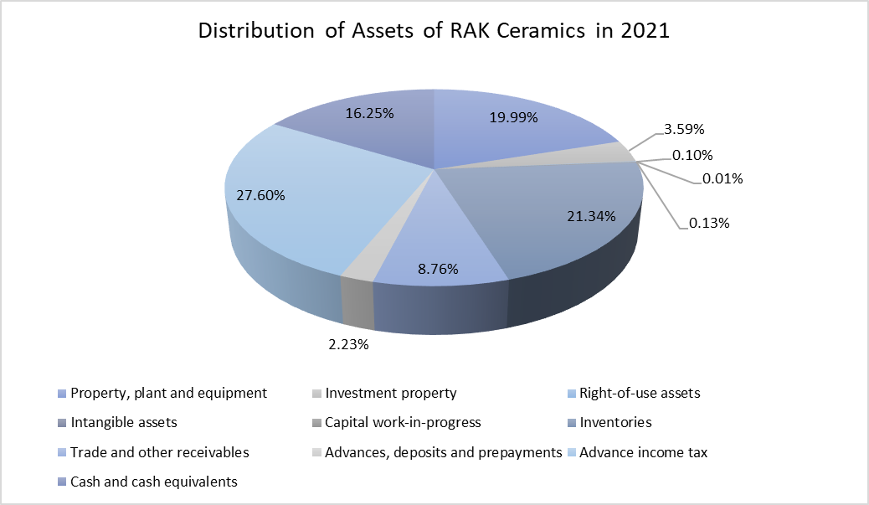
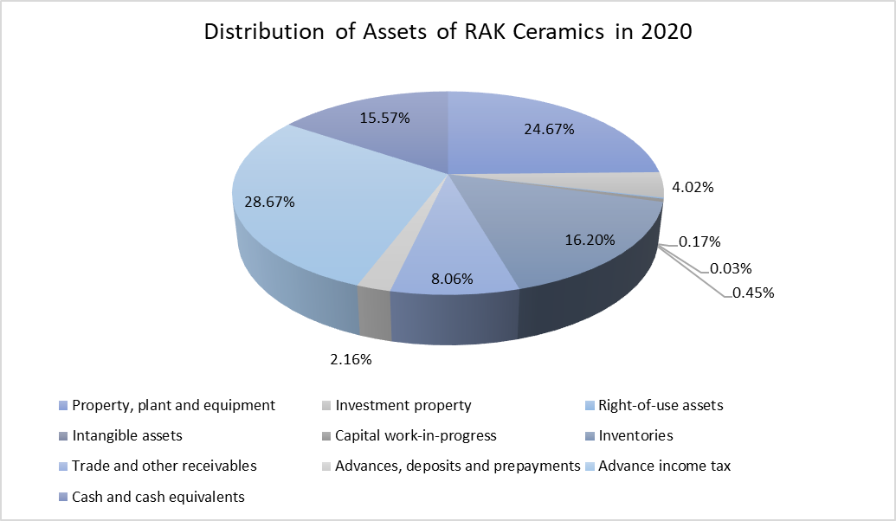
Major portion in Assets
Property, Plant and equipment & Advance income tax
Major portion in Assets -
Property, Plant and equipment & Advance income tax

Slide 13
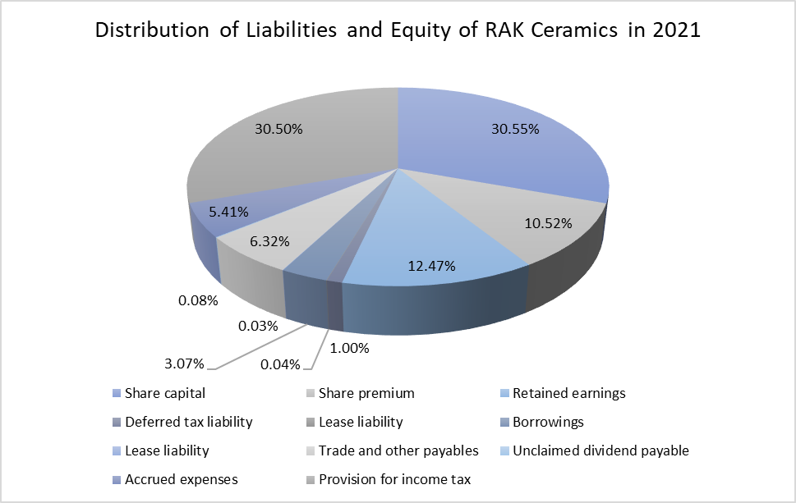
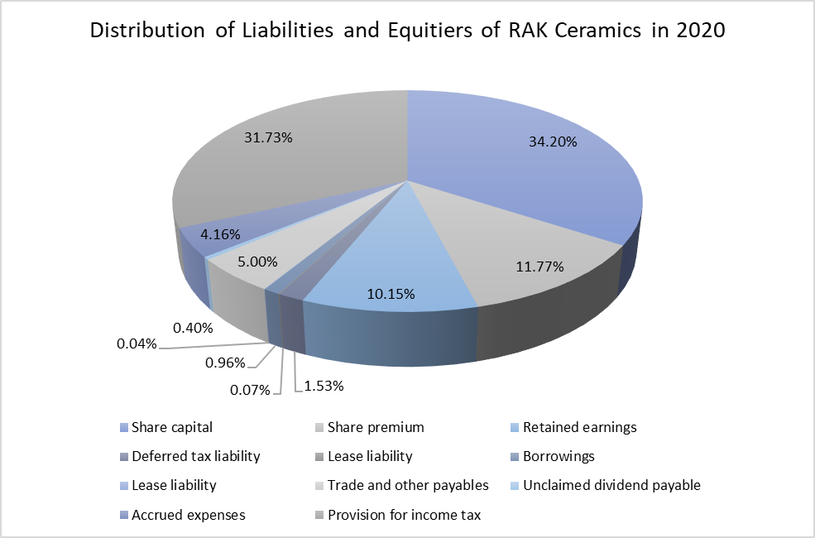
Major portion in Equity and Liabilities
Share Capital & Provision for income tax
Major portion in Equity and Liabilities -
Share Capital & Provision for income tax

Slide 14

Shinepukur
Ceramics Ltd.

Slide 15
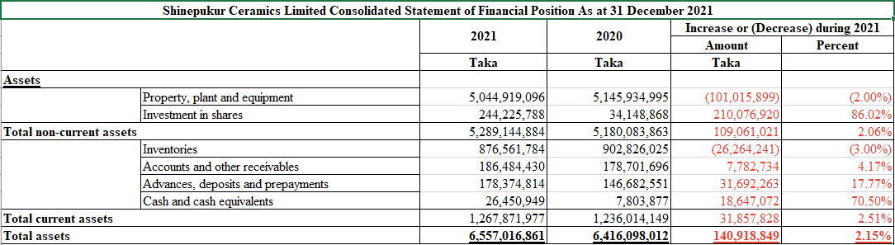
Horizontal Analysis

Slide 16
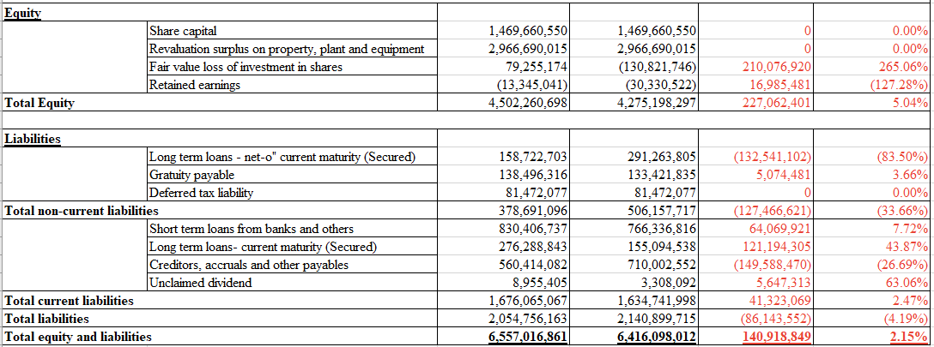
Horizontal Analysis

Slide 17
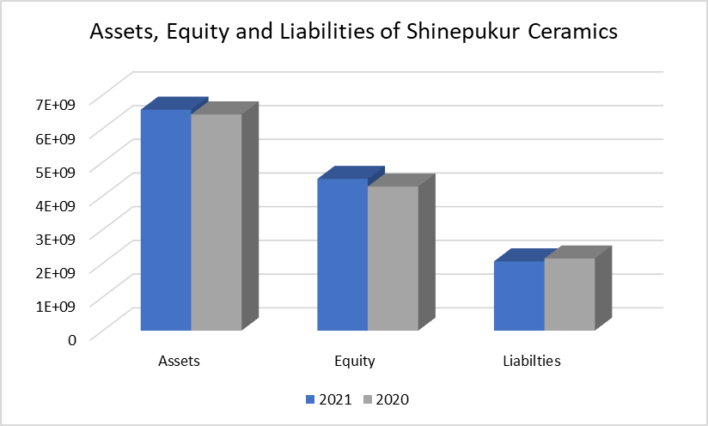

Slide 18
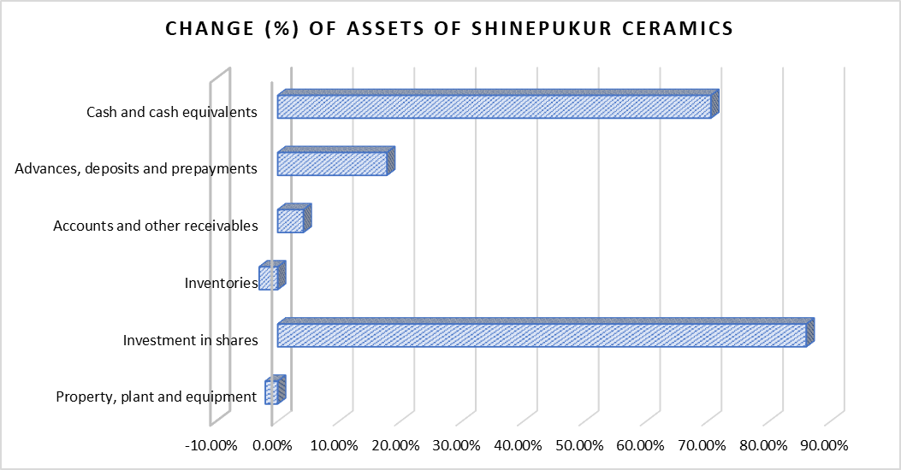
Increase in total Assets
2.15%
Major contribution
Investment in shares
Cash and Cash Equivalent

Slide 19
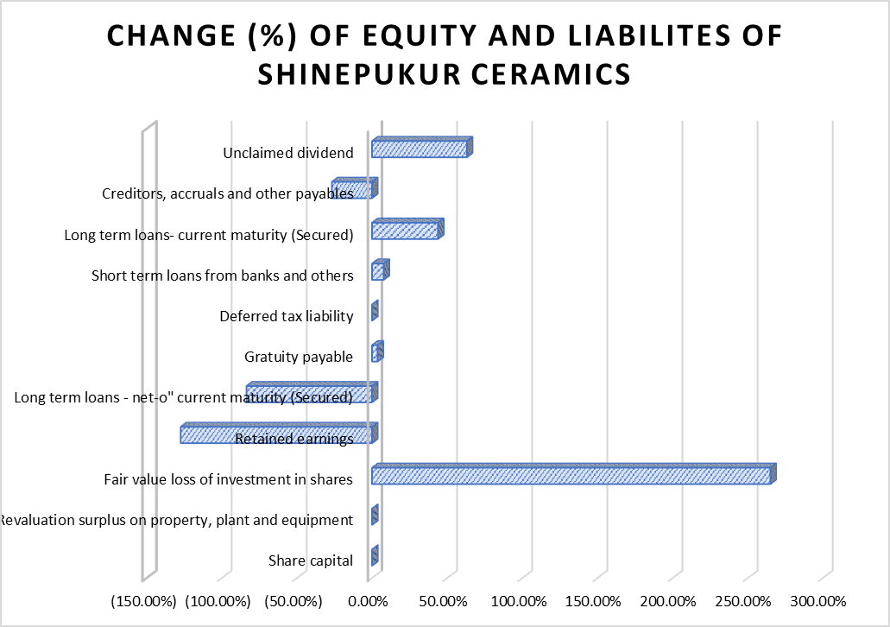
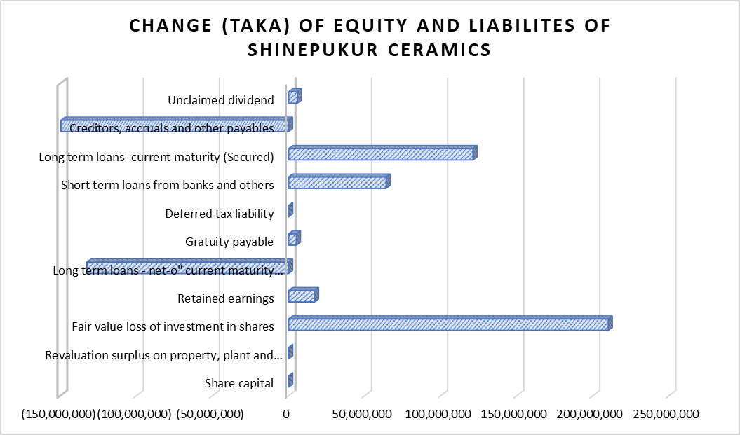

Slide 20
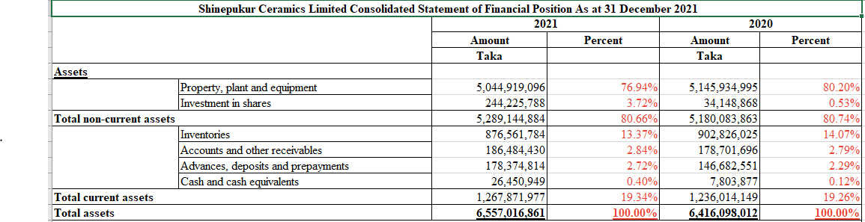
Vertical Analysis

Slide 21
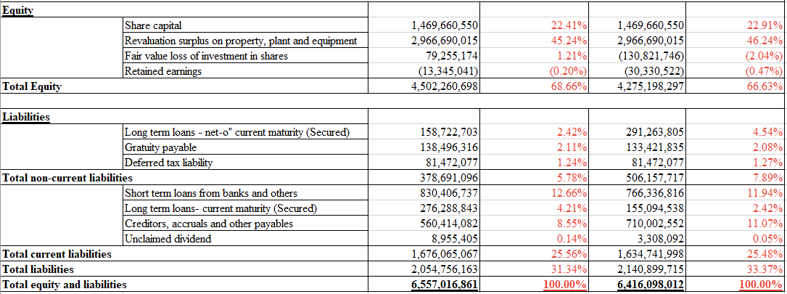
Vertical Analysis

Slide 22
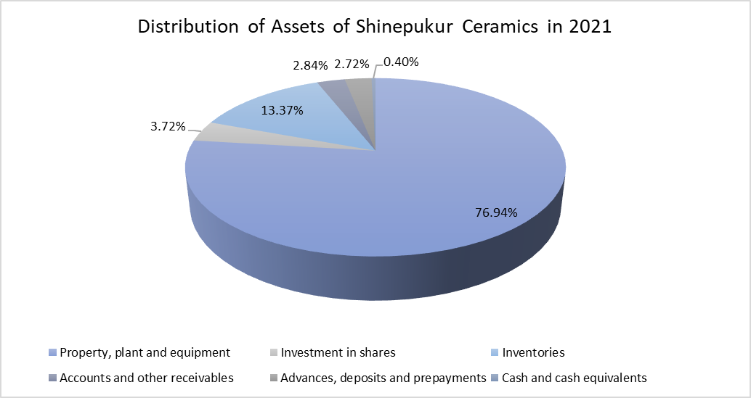
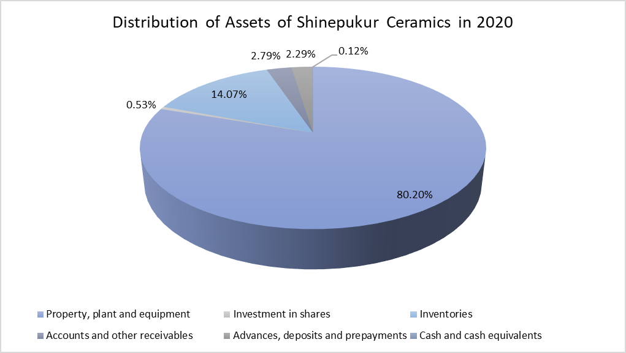
Major portion in Assets
Property, Plant and equipment & Inventories

Slide 23
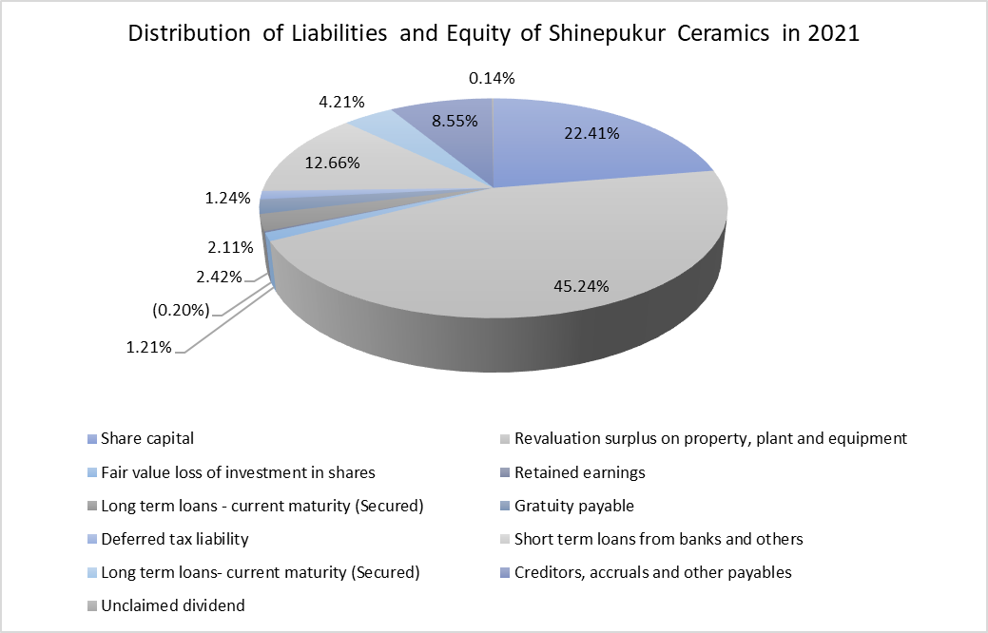
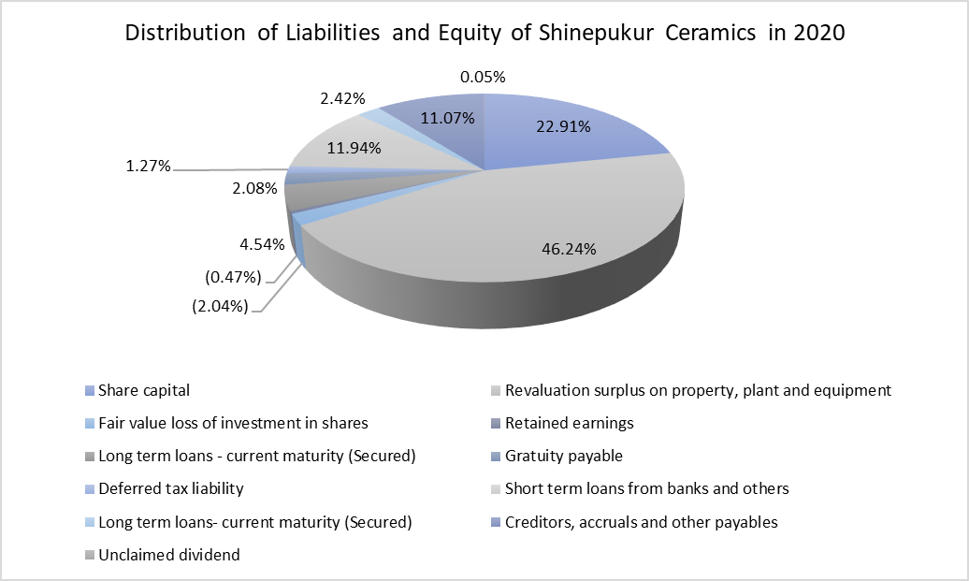
Major portion in Equity and Liabilities
Issued Share Capital & Revaluation Surplus on Property, Plant and Equipment

Slide 24
InterCompany Analysis
RAK
v/s
Shinepukur

Slide 25
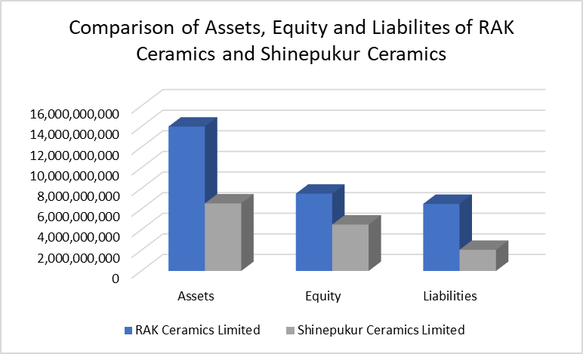
Composition of Assets, Equity and Liabilities
RAK leads with 14B taka in Assets against Shinepukur’s 6.5B taka roughly 53% higher.
RAK has 40% higher Equity and 68% higher liabilities.

Slide 26
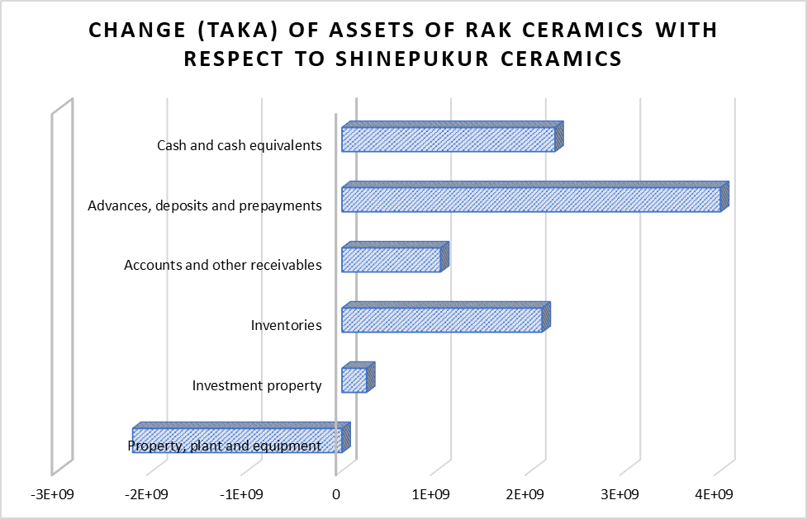
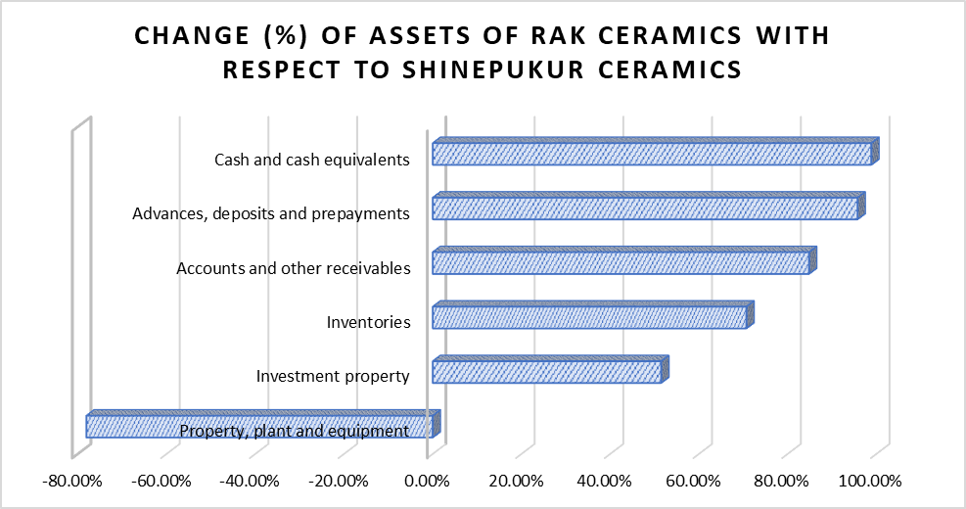
Increase in total Assets of RAK
53.19%
Major contribution
Advances, deposits and prepayments
Cash and cash equivalents

Slide 27
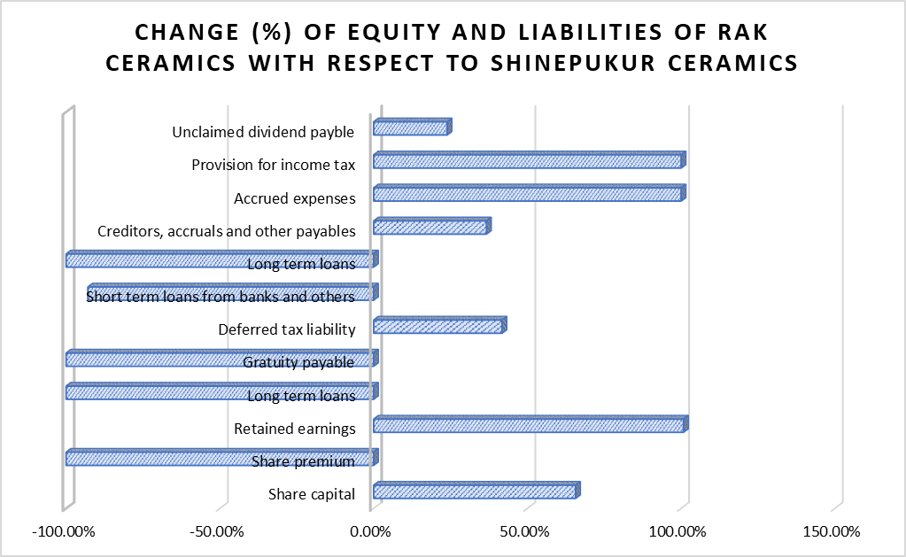
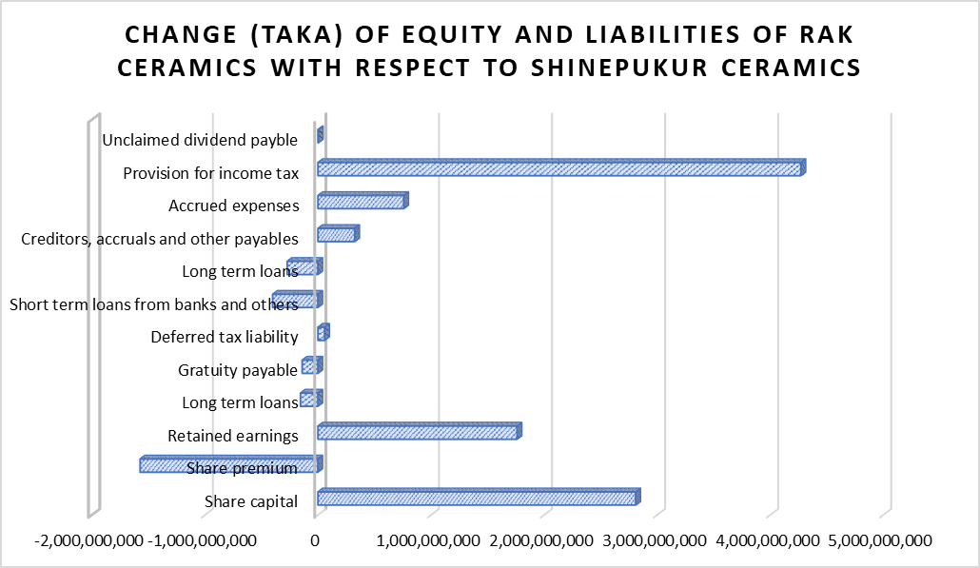
Change of Equity and Liabilities

Slide 28
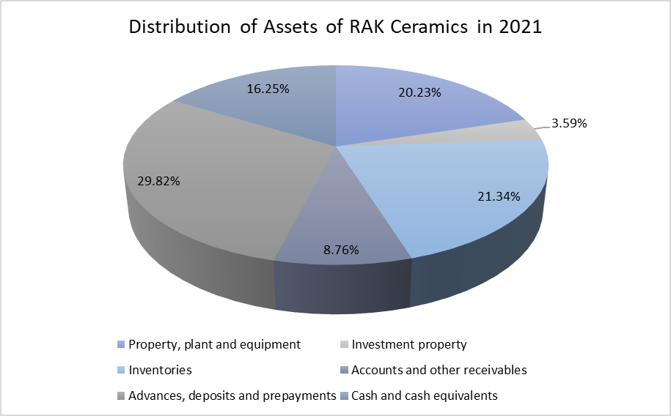
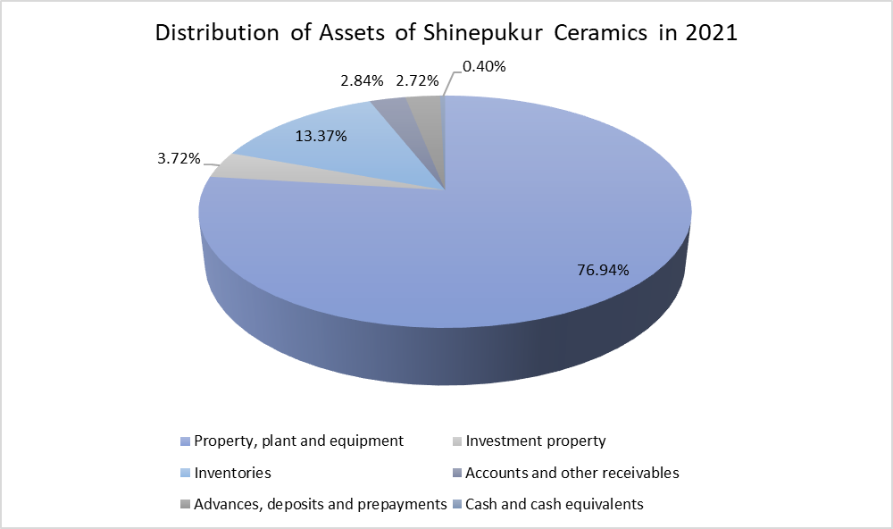
RAK
Total Current Assets (76.18%)
Total Non-Current Assets (23.82%)
Shinepukur
Total Current Assets (19.34%)
Total Non-Current Assets (80.66%)

Slide 29
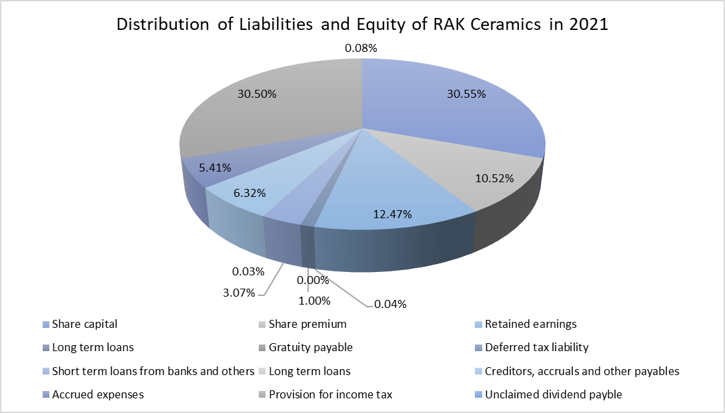
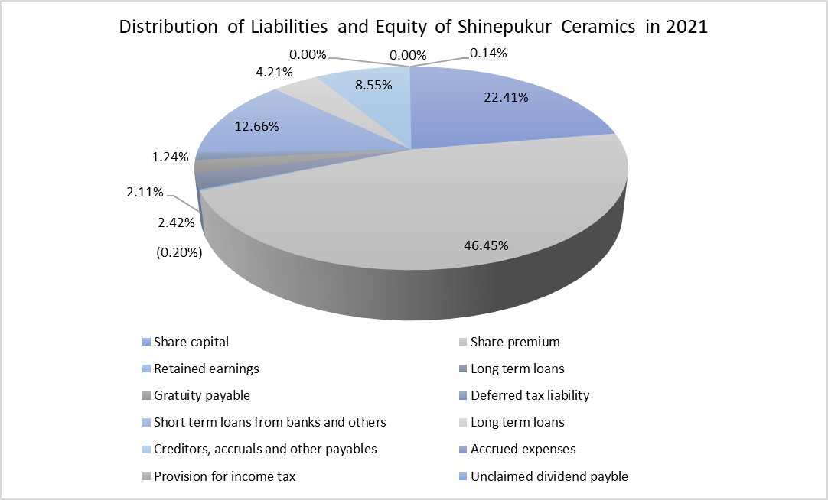
RAK
Total Equity (53.55%)
Total Liabilities (46.45%)
Shinepukur
Total Equity (68.66%)
Total Liabilities (31.34%)

Slide 30
Ratio Analysis

Slide 31
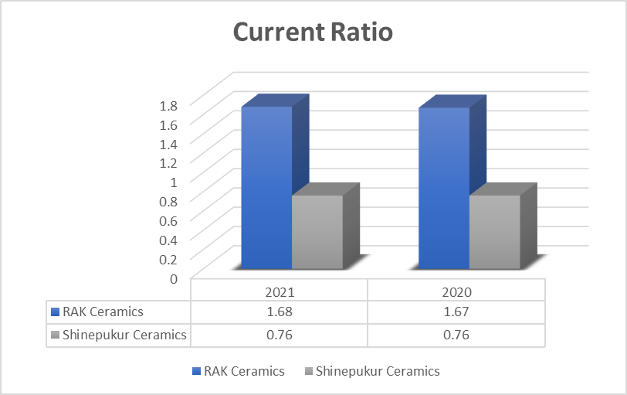
Current Ratio
Ratio | Formula | RAK Ceramics |  | Shinepukur
 |  | 2021 | 2020 | 2021 | 2020
Current Ratio | Current Assets | 1.68:1 | 1.67:1 | 0.76:1 | 0.76:1
 | Current Liabilities

Slide 32
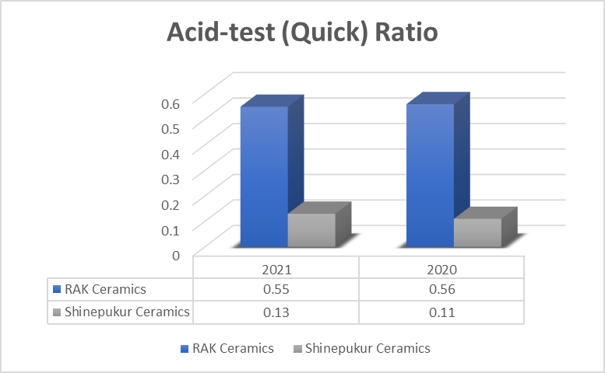
Acid-test (quick) ratio
Ratio | Formula | RAK Ceramics |  | Shinepukur
 |  | 2021 | 2020 | 2021 | 2020
Acid-test (quick) Ratio | Cash + Short-term Investments + Receivables (net) | 0.55:1 | 0.56:1 | 0.13:1 | 0.11:1
 | Current Liabilities

Slide 33
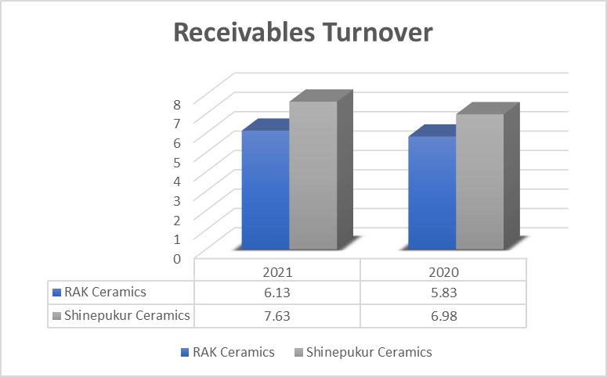
Receivables Turnover
Ratio | Formula | RAK Ceramics |  | Shinepukur
 |  | 2021 | 2020 | 2021 | 2020
Receivables Turnover | Net Credit Sales | 6.13 | 5.83 | 7.63 | 6.98
 | Average Net Receivables

Slide 34
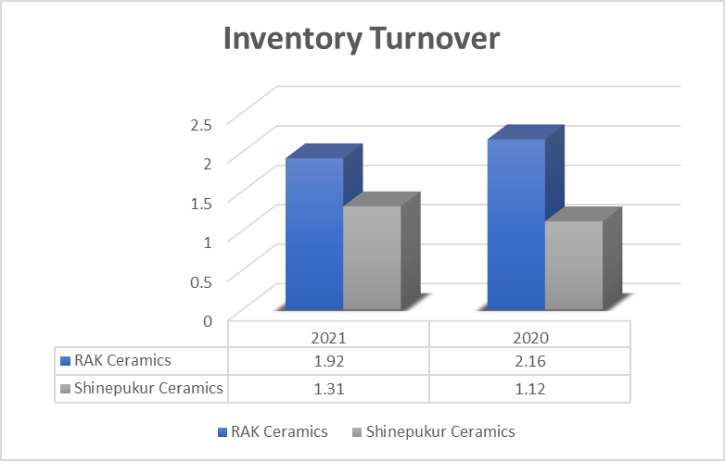
Inventory Turnover
Ratio | Formula | RAK Ceramics |  | Shinepukur
 |  | 2021 | 2020 | 2021 | 2020
Inventory Turnover | Cost of Goods Sold | 1.92 | 2.16 | 1.31 | 1.12
 | Average Inventory

Slide 35
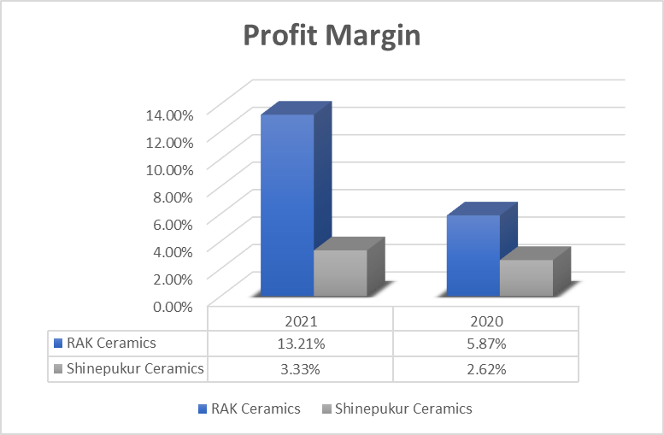
Profit Margin
Ratio | Formula | RAK Ceramics |  | Shinepukur
 |  | 2021 | 2020 | 2021 | 2020
Profit Margin | Net Income | 13.21% | 5.87% | 3.33% | 2.62%
 | Net Sales

Slide 36
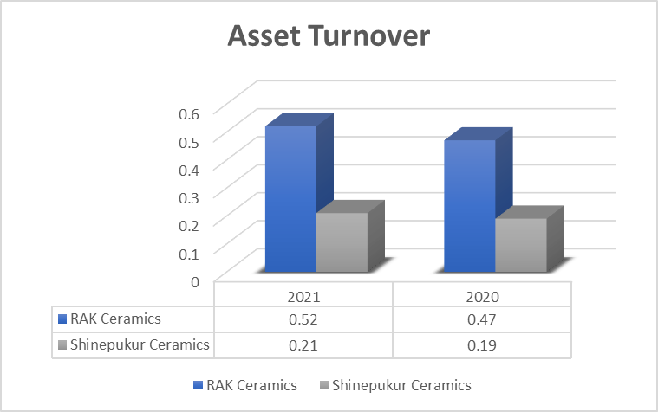
Asset Turnover
Ratio | Formula | RAK Ceramics |  | Shinepukur
 |  | 2021 | 2020 | 2021 | 2020
Asset Turnover | Net Sales | 0.52 | 0.47 | 0.21 | 0.19
 | Average Assets

Slide 37
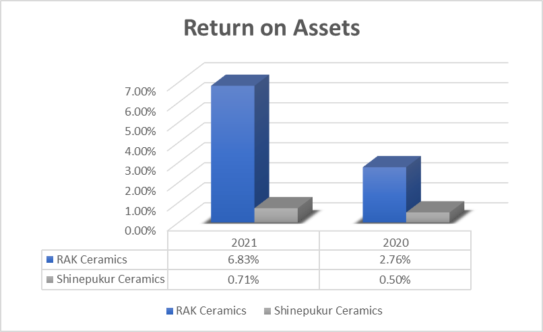
Return on Assets
Ratio | Formula | RAK Ceramics |  | Shinepukur
 |  | 2021 | 2020 | 2021 | 2020
Return on Assets | Net Income | 6.83% | 2.76% | 0.71% | 0.50%
 | Average Assets

Slide 38
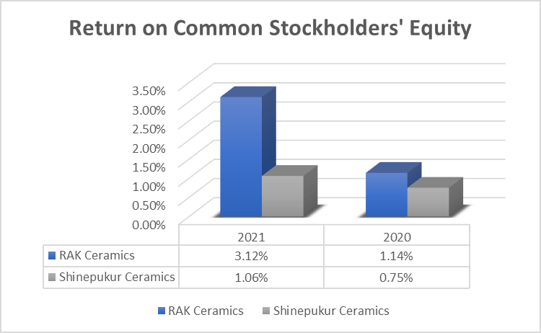
Return on Common Stockholders’ Equity
Ratio | Formula | RAK Ceramics |  | Shinepukur
 |  | 2021 | 2020 | 2021 | 2020
Return on Common Stockholders' Equity | Net Income - Preferred Dividends | 3.12% | 1.14% | 1.06% | 0.7%
 | Average Common Stockholders’ Equity

Slide 39
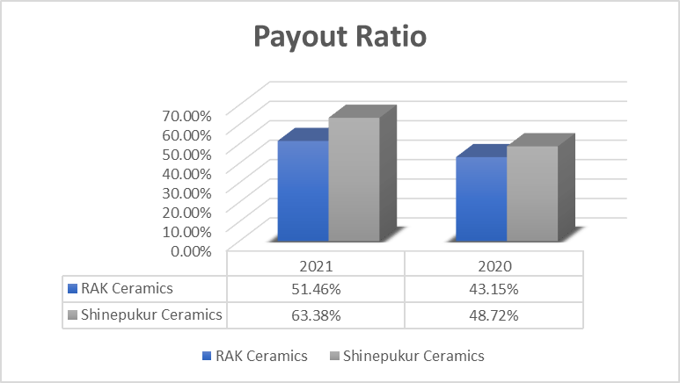
Payout Ratio
Ratio | Formula | RAK Ceramics |  | Shinepukur
 |  | 2021 | 2020 | 2021 | 2020
Payout Ratio | Cash Dividends | 51.46% | 43.1% | 63.38% | 48.7%
 | Net Income

Slide 40
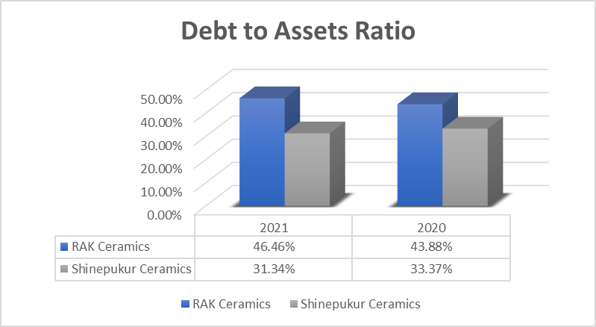
Debt to Assets Ratio
Ratio | Formula | RAK Ceramics |  | Shinepukur
 |  | 2021 | 2020 | 2021 | 2020
Debt to Assets Ratio | Total Debt | 46.46% | 43.8% | 31.34% | 33.3%
 | Total Assets

Slide 41
Thank you

